Slide 1

Advances of Machine Learning in Finance: Support Vector Machines (SVM) with R
Hadi Movaghari
2022-2023
مسیر برنامه رو عوض کن

Slide 2
Outline
Section 1: Preliminaries
Section 2:Example 1: iris dataset
Section 3:Example 2: An application in finance
Advances of Machine Learning in Finance: SVM with R
University of Glasgow
2022-2023

Slide 3
Section 1: Preliminaries

Slide 4
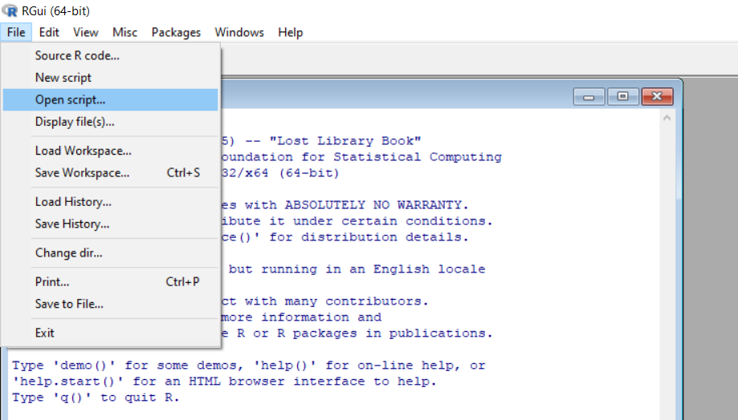
Open your script file!
Download files (script, data, PowerPoint) from Moodle or the following GitHub page: https://github.com/hadigilan/AdvMLFinance_SVM.git
From File -> Open script find your file and then open
Advances of Machine Learning in Finance: SVM with R
University of Glasgow
2022-2023

Slide 5
SVM packages
To implement SVM analysis in R, we use e1071 package.
Other packages to implement SVM or its generalizations include:
gensvm: Generalized Multiclass Support Vector Machine
gkmSVM: Gapped-Kmer Support Vector Machine
ramsvm: Reinforced Angle-Based Multicategory Support Vector Machines
SSOSVM: Stream Suitable Online Support Vector Machines
survivalsvm: Survival Support Vector Analysis
WeightSVM: Subject Weighted Support Vector Machines
Advances of Machine Learning in Finance: SVM with R
University of Glasgow
2022-2023

Slide 6
Installing package
To install the package run the following code:
install.packages(“e1071")
After installing a package, it is required to load it:
library(e1071)
Advances of Machine Learning in Finance: SVM with R
University of Glasgow
2022-2023

Slide 7
e1071 package
The function to implement SVM in the e1071 package is svm with following main arguments:
formula
a symbolic description of the model to be fit.
x
a data matrix
y
scale
a response vector. Can be either a factor (for classification tasks) or a numeric vector (for regression).
type
A logical vector indicating the variables to be scaled. By default, data are scaled internally (both x and y)
The purpose of running SVM
the kernel used in training and predicting
kernal
data
introduces the dataset used to estimate SVM
Advances of Machine Learning in Finance: SVM with R
University of Glasgow
2022-2023

Slide 8
e1071 package (Cont’d)
The type argument could be one of the following options, depending on the nature of response:
C-classification
nu-classification
one-classification (for novelty detection)
eps-regression
nu-regression
The kernel argument could be one of the following options, the default is "radial“ for a non-linear SVM
linear
polynomial
radial basis
sigmoid
Advances of Machine Learning in Finance: SVM with R
University of Glasgow
2022-2023

Slide 9
e1071 package (Cont’d)
Other classifiers available in e1071 and relevant functions:
Naive Bayes classifier ➔ naiveBayes
Fuzzy classifier ➔ cshell & cmeans
Bagged clustering ➔ bclust
Generalized k-nearest neighbour ➔ gknn
Advances of Machine Learning in Finance: SVM with R
University of Glasgow
2022-2023

Slide 10
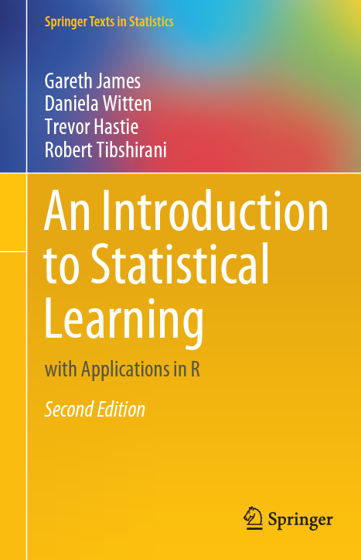
Online sources for e1071
A Textbook
An introduction to statistical learning: with applications in R. Second Edition.
by James, G. Witten, D., Hastie, T., Tibshirani, R. (2021).
Chapter 9
Available online
Advances of Machine Learning in Finance: SVM with R
University of Glasgow
2022-2023

Slide 11
Online sources for e1071
Articles
You can download the manual of the package from https://cran.r-project.org/web/packages/e1071/e1071.pdf
A vignette written by the developer of the package
https://cran.r-project.org/web/packages/e1071/vignettes/svmdoc.pdf
Advances of Machine Learning in Finance: SVM with R
University of Glasgow
2022-2023

Slide 12
Section 2: Example 1: iris dataset

Slide 13
Data description
Perhaps the best-known database to be found in statistical literature, provided by R.A. Fisher
The data set contains:
3 classes of iris flower (virginica, versicolor, setosa)
4 relevant explanatory variables (sepal length, sepal width, petal length, petal width)
We will use sepal length, sepal width, petal length and petal width to predict the species of flower.
Advances of Machine Learning in Finance: SVM with R
University of Glasgow
2022-2023

Slide 14
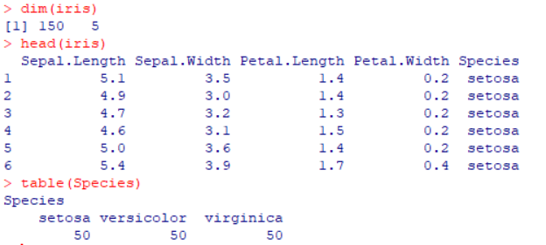
Data description (Cont’d)
data(iris)
attach(iris)
dim(iris)
head(iris)
table(Species)
data loads a dataset
attach makes objects in a database can be accessed by simply giving their names.
head shows the first rows of the object
table creates a frequency table
Advances of Machine Learning in Finance: SVM with R
University of Glasgow
2022-2023

Slide 15
Data description (Cont’d)
It is well-known that in the iris dataset one class (setosa) is linearly separable from the other 2; the latter (virginica, versicolor) are not linearly separable from each other.
pairs creates a scatterplot matrix
The argument col colors points by iris classes
oma controls the margin of the figure
par(xpd = TRUE) allows inserting legend outside the plot area
pairs(iris[,1:4], col=Species, pch=16, lower.panel = NULL, oma=c(3,3,3,15))
par(xpd = TRUE)
legend("bottomright", fill = unique(Species), legend = levels(Species) )
Advances of Machine Learning in Finance: SVM with R
University of Glasgow
2022-2023

Slide 16
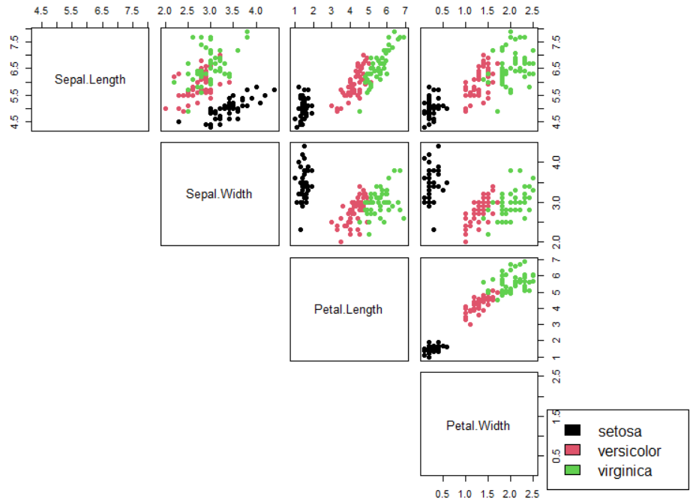

Slide 17
SVM with linear kernel
To conduct SVM analysis, use svm function
For a linear SVM, set kernel argument to “linear”
Since iris dataset totally contains five columns, with one column for dependent variable, we can introduce the inputs with a . symbol.
svm.linear <- svm(Species ~ . , data=iris, kernel="linear")
Advances of Machine Learning in Finance: SVM with R
University of Glasgow
2022-2023

Slide 18
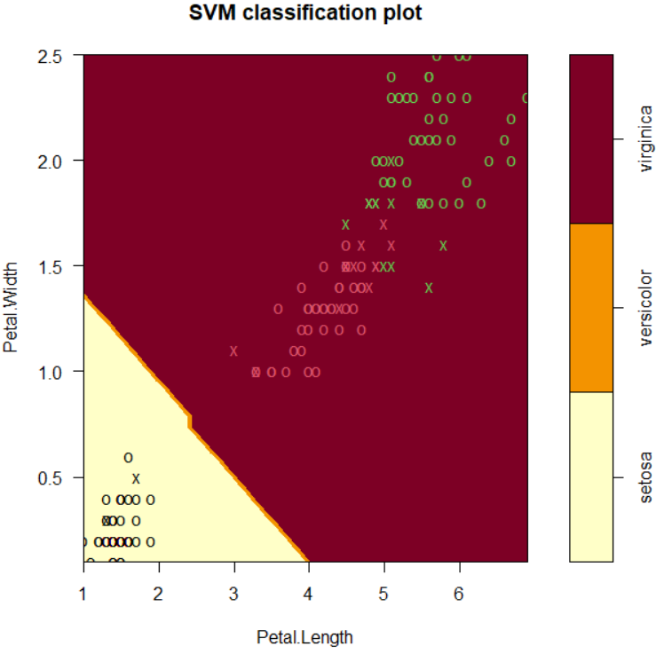
plot(svm.linear , Petal.Width ~ Petal.Length, data=iris)
Since in the fitting SVM we used four inputs, we need to specify the two variables that we want to plot the classification results
svm.linear is the name of svm function’s output
To plot the svm results we need to specify the dataset’s name
It is clear that SVM with linear kernel does not successful in classifying virginica and versicolor species which are not linearly separable.

Slide 19
SVM with non-linear kernel
svm.radial <- svm(Species ~ ., data=iris, kernel="radial")
For a non-linear SVM, set kernel argument to “radial”
Advances of Machine Learning in Finance: SVM with R
University of Glasgow
2022-2023

Slide 20
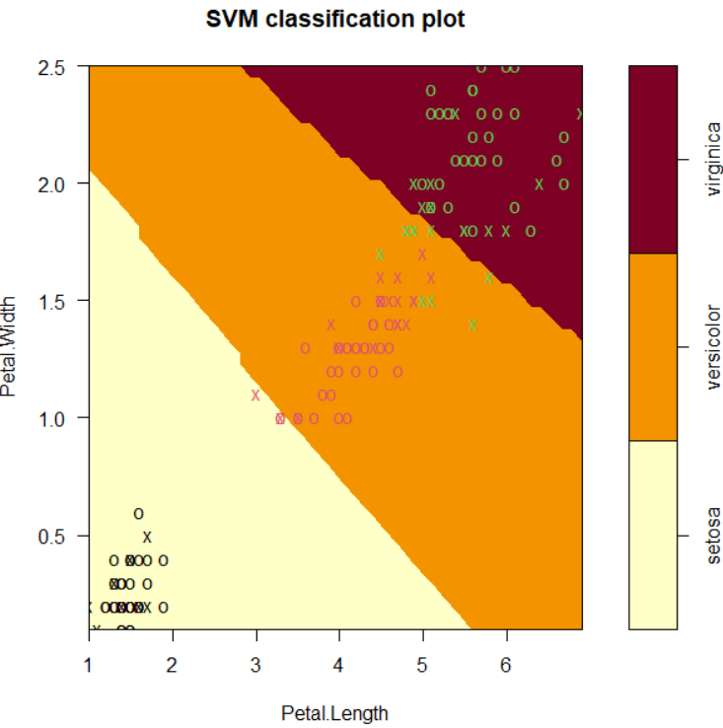
plot(svm.radial, data=iris, Petal.Width ~ Petal.Length,
slice = list(Sepal.Width=3, Sepal.Length=4) )
slice is a list of named values for the dimensions held constant
It seems SVM model with non-linear kernel to be a very good model for iris dataset.

Slide 21
Section 3: Example 2: An application in finance

Slide 22
The dataset
The dataset consists of 1,633 firm-year observations from 304 unique firm listed in Tehran Stock Exchange (TSE), Iran, between 2009-2016.
Dependent variable is a dummy variable for dividend payment (1 for dividend paying firms, 0 otherwise)
There exist 13 explanatory variables including: firm size, market-to-book ratio, leverage, return on assets, business risk, cash holdings, firm’s growth, effective tax rate, current ratio, fixed assets, firm age, life-cycle stage, liquidity.
We use SVM to classify dividend paying and non-dividend paying firms
Advances of Machine Learning in Finance: SVM with R
University of Glasgow
2022-2023

Slide 23
Importing data
dps<- read.table("C:\\data.txt", header=T)
attach(dps)
head(dps)
dim(dps)
table(year)
length(unique(firm))
We assume that your data is in a text file
read.table is a function to read text files
Put the path of your file between “ “
Use \\ or / to separate paths.
length returns the number of entries in a objects
Advances of Machine Learning in Finance: SVM with R
University of Glasgow
2022-2023

Slide 24
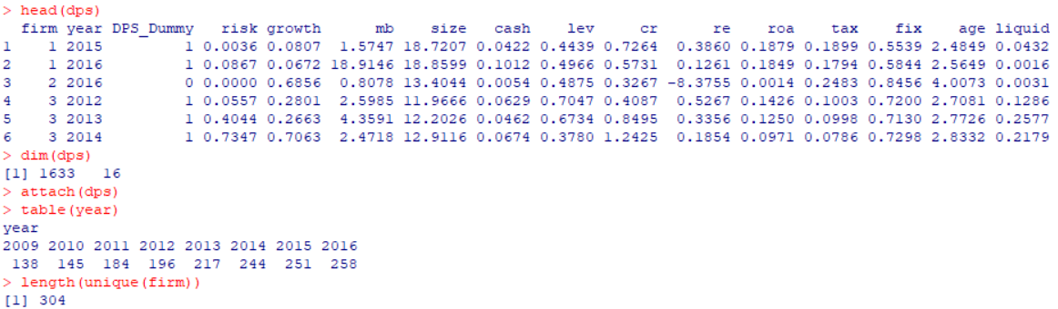
Importing data (Cont’d)
Advances of Machine Learning in Finance: SVM with R
University of Glasgow
2022-2023

Slide 25
SVM with non-liner kernel
dps.svm<- svm( as.factor(DPS_Dummy) ~ risk + growth + mb + size + cash + lev + cr + re + roa + tax + fix + age + liquid, data=dps)
pred.svm <- predict(dps.svm, dps)
By default kernel is set to “radial”
Since the dependent variable is a numeric dummy variable, we convert it to a factor variable by as.factor function
predict is a generic function to predict from a fitted model.
Advances of Machine Learning in Finance: SVM with R
University of Glasgow
2022-2023

Slide 26
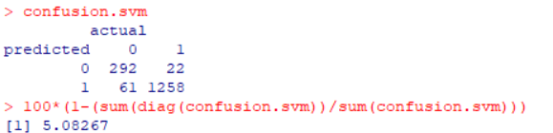
Confusion matrix
As a measure to evaluate the performance of fitted SVM, we can calculate the missclassification rate
According to the confusion matrix:
61 non-dividend paying firms are mistakenly classified as dividend paying firms
22 dividend paying firms are mistakenly classified as non-dividend paying firms
Missclassification rate for SVM is about 5%
confusion.svm<- table(predicted = pred.svm , actual = dps$DPS_Dummy)
confusion.svm
100*(1-(sum(diag(Confusion.svm))/sum(Confusion.svm)))
Advances of Machine Learning in Finance: SVM with R
University of Glasgow
2022-2023

Slide 27
Comparison with LASSO
library(glmnet)
x<- as.matrix(dps[ ,4:16])
y<- dps$DPS_Dummy
dps.cv.lasso<- cv.glmnet(x, y, family = "binomial", alpha=1)
bestlam<- dps.cv.lasso$lambda.min
dps.lasso<- glmnet(x, y, family = "binomial", alpha=1, lambda=bestlam)
pred.lasso<- predict(dps.lasso, newx = x, type='class' )
For a fitting logistic regression using glmnet and cv.glmnet functions, we use family="binomial“
To get predictions for classifications use type='class’
alpha=1 is for LASSO penalty function
Advances of Machine Learning in Finance: SVM with R
University of Glasgow
2022-2023

Slide 28
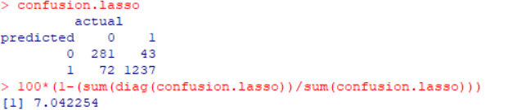
Comparison with LASSO (Cont’d)
According to the confusion matrix:
72 non-dividend paying firms are mistakenly classified as dividend paying firms
43 dividend paying firms are mistakenly classified as non-dividend paying firms
Missclassification rate for LASSO is about 7%
confusion.lasso<- table(predicted=pred.lasso, actual = dps$DPS_Dummy)
100*(1-(sum(diag(confusion.lasso))/sum(confusion.lasso)))
Advances of Machine Learning in Finance: SVM with R
University of Glasgow
2022-2023

Slide 29
Contact
If you have any question regarding R programming and financial econometrics, or any suggestion to improve the teaching style, please feel free to contact me through:
hadi.movaghari@glasgow.ac.uk
Advances of Machine Learning in Finance: SVM with R
University of Glasgow
2022-2023

